Slide 1
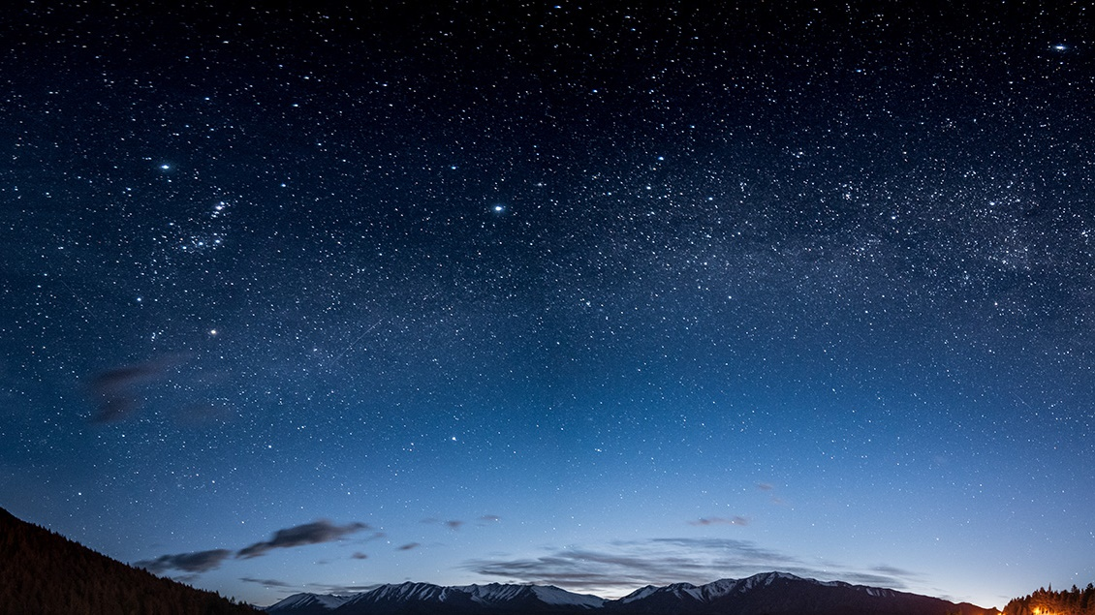
Hand gesture recognition using python
Presented by:
Devasena Pasupuleti

Slide 2
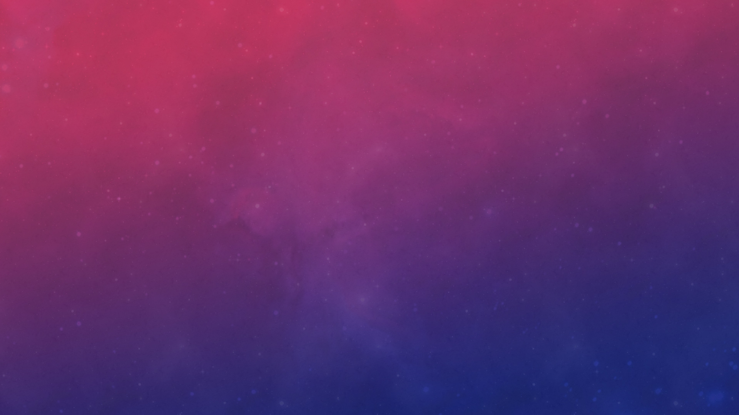

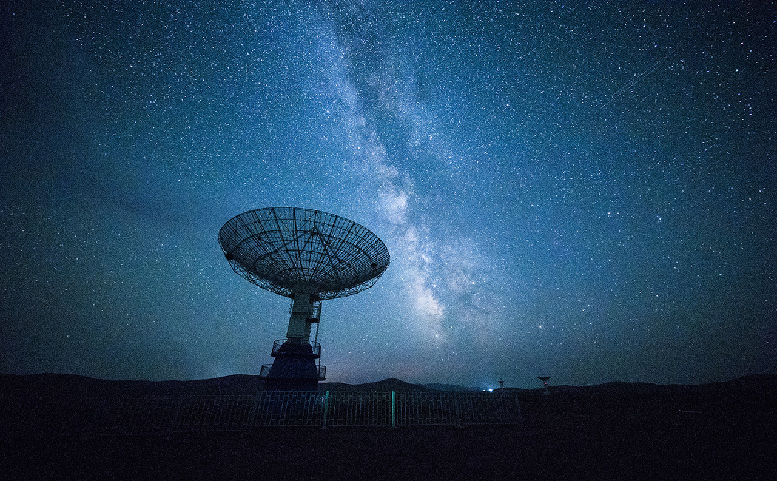
Contents
Problem definition
Objective
Proposed method
Working code

Slide 3
Problem definition:
Hand gesture recognition is one of the main aspects of computer vision.
It’s applications include: to communicate in and understand sign language, navigate autonomous robots and in the field of computer science, medicine etc.
A static control board like keyboard or mouse restrains and limits the capacity of the user as they can be easily lost, dropped or broken and also the user should be physical near it at all times to use it.
Objective:
To establish a complete system for detecting (image acquisition and pre-processing), recognizing (feature extraction) and interpreting hand gesture recognition through computer vision using Python (OpenCV library) which can operate like a keyboard or a mouse to control the operations performed by VLC media player.

Slide 4
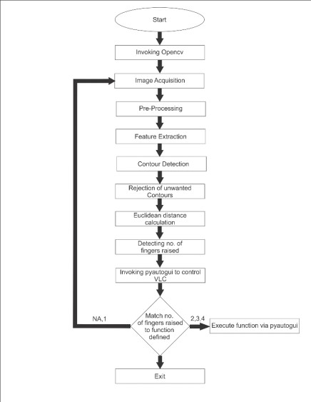
Proposed method:
Continuously capture various frames using a web camera to get the raw input data (Acquisition)
Define the Region of Interest (ROI)
Convert input image to HSV format from its original RGB form
Create a skin mask to highlight specific colors in an image (image segmentation)
To avoid external or internal noises present in the image, blur it (pre-processing)
Perform feature extraction operations ( find contour, convex hull and the number of defects)
Connect the python script to VLC media player using pyautogui command
Architectural Diagram

Slide 5
Operations performed while implementing code:
Obtaining data:
Capturing frames from real time webcam
Defining the region of interest
2. Data pre-processing:
Segmentation: Thresholding operation (converting RGB format to HSV and creating a mask)
Morphological filtering: Dilation (after performing gaussian blur)
3. Extraction of features:
Finding and approximating contours
Finding convex hull
Mathematical operations (cosine rule to find angle between the fingers)

Slide 6
Python CODE
import cv2
import numpy as np
import math
import pyautogui
cap = cv2.VideoCapture(0)
#Import all the required libraries
#the library responsible for controlling VLC media player
#capture frames continuously using a single real time web camera

Slide 7
while(1):
try:
ret, frame = cap.read()
frame=cv2.flip(frame,1)
roi=frame[100:300, 100:300]
cv2.rectangle(frame,(100,100),(300,300),(0,255,0),0)
#an error comes if it does not find anything in window as it cannot find contour of max area, therefore this try error statement
#read the input images captured from the webcam frame by frame(returns true/false value)
#flip each frame about y axis to avoid confusion on which hand you are currently using
#define which pixels will come under the region of interest within the entire frame captured.
#create a green rectangular box to visually define the region of interest(starting at (100,100) and ending at (200,200)

Slide 8
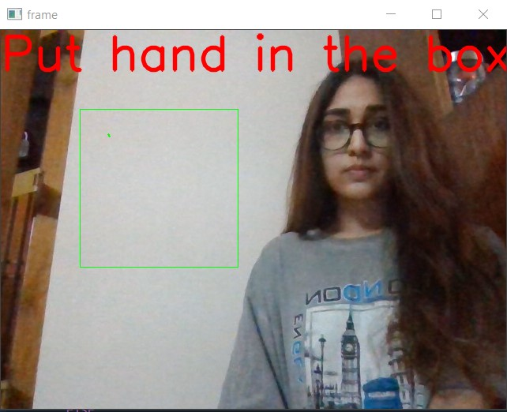
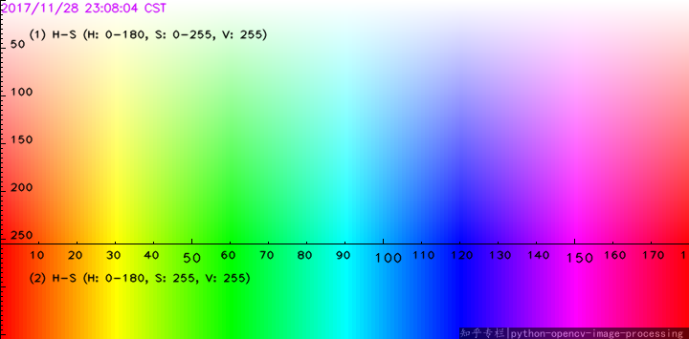
The green rectangle within the frame represents the region of interest(ROI)
The H(hue)-S(saturation)-V(value) colour code graph

Slide 9
hsv = cv2.cvtColor(roi, cv2.COLOR_BGR2HSV)
lower_skin = np.array([0,20,70], dtype=np.uint8)
upper_skin = np.array([20,255,255], dtype=np.uint8)
mask = cv2.inRange(hsv, lower_skin, upper_skin)
kernel = np.ones((3,3),np.uint8)
mask = cv2.dilate(mask,kernel,iterations = 2)
mask = cv2.GaussianBlur(mask,(5,5),100)
#convert the real time RGB image to a HSV image, which makes it easier to segment objects based on its color
#define the range of H, S and V values according to skin color
#this range represents a whitish-peach color (color of users hand can be adjusted)
#this creates a binary image where only your hand(which we defined as peach colour) is extracted from the background(black)
#create an 8 bit rectangular 3x3 kernel filled with ones for dilation operation
#fill in the empty dark spots in the binary hand image through dilation to make it clearly visible
#blur the image to reduce noise and get a smoothened version of the image

Slide 10
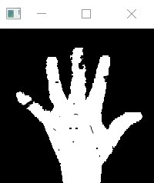
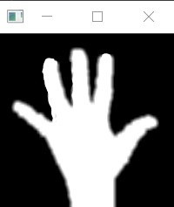
Morphological operations
Thresholding before dilation and gaussian blur
Thresholding after dilation and gaussian blur

Slide 11
contours,hierarchy= cv2.findContours(mask,cv2.RETR_TREE,
cv2.CHAIN_APPROX_SIMPLE)
cnt = max(contours, key = lambda x: cv2.contourArea(x))
epsilon = 0.0005*cv2.arcLength(cnt,True)
approx= cv2.approxPolyDP(cnt,epsilon,True)
hull = cv2.convexHull(cnt)
areahull = cv2.contourArea(hull)
areacnt = cv2.contourArea(cnt)
arearatio=((areahull-areacnt)/areacnt)*100
hull = cv2.convexHull(approx, returnPoints=False)
defects = cv2.convexityDefects(approx, hull)
#this gives the list of all the contours in the image
#find contour of max area of interest, in this case, our hand
#approximate the contour for better boundary detection
#make convex hull around hand
#define area of hull and area of hand
#find the percentage of area not covered by hand in convex hull
#find the convex hull of the approximated hand and the defects

Slide 12
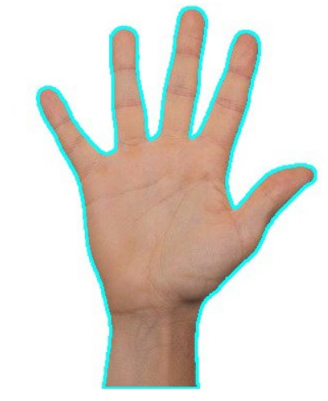
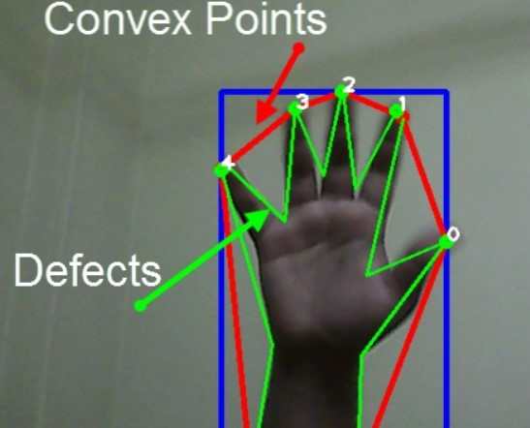
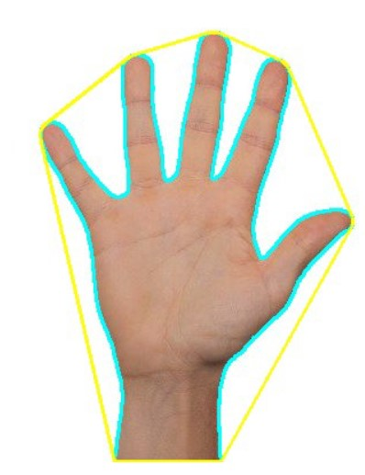
Segmentation operations
Finding Contours:
Find and correct the convex hull:
3. Find the defects:

Slide 13
l=0
for i in range(defects.shape[0]):
s,e,f,d = defects[i,0]
start = tuple(approx[s][0])
end = tuple(approx[e][0])
far = tuple(approx[f][0])
a = math.sqrt((end[0] - start[0])**2 + (end[1] - start[1])**2)
b = math.sqrt((far[0] - start[0])**2 + (far[1] - start[1])**2)
c = math.sqrt((end[0] - far[0])**2 + (end[1] - far[1])**2)
s = (a+b+c)/2
ar = math.sqrt(s*(s-a)*(s-b)*(s-c))
d=(2*ar)/a
angle = math.acos((b**2 + c**2 - a**2)/(2*b*c)) * 57
if angle <= 90 and d>30:
l += 1
cv2.circle(roi, far, 3, [255,0,0], -1)
cv2.line(roi,start, end, [0,255,0], 2)
#define a variable to store the number of defects
#find the no. of defects due to fingers
# find length of all sides of triangle formed between the two fingers
#find semi-perimeter of triangle
#find distance between defect point and convex hull
#find angle from the cosine law
# ignore angles > 90 and ignore points very close to convex hull(they generally come due to noise)
#represent the defects as circular blue points and draw lines around hand boundary within the region of interest

Slide 14
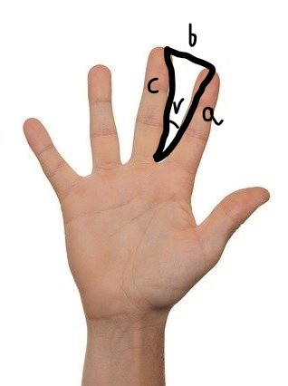
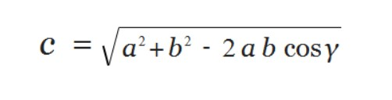
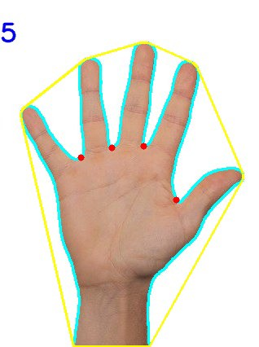
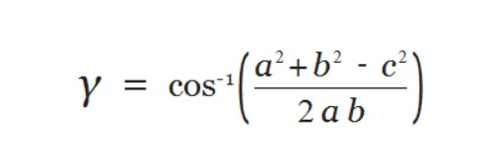
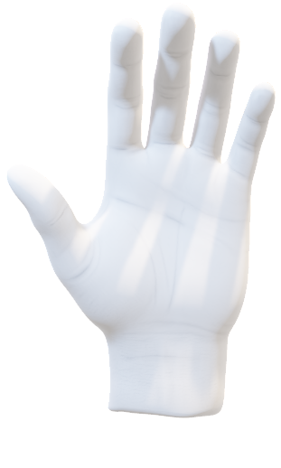
Law of cosines: It relates the lengths of the sides of a triangle to the cosine of one of its angles.
In the equation below, γ denotes the angle contained between sides of lengths a and b and is opposite to the side of length c.
Cosine theorem to find angle between fingers
The defects are represented as red dots

Slide 15
if l==0:
if areacnt<2000:
cv2.putText(frame,'Put hand in the box',(0,50), font, 2, (0,0,255), 3, cv2.LINE_AA)
else:
if arearatio<12:
cv2.putText(frame,'0',(0,50), font, 2, (0,0,255), 3, cv2.LINE_AA)
else:
cv2.putText(frame,'1',(0,50), font, 2, (0,0,255), 3, cv2.LINE_AA)
elif l==1:
cv2.putText(frame,'2',(0,50), font, 2, (0,0,255), 3, cv2.LINE_AA)
elif l==2:
cv2.putText(frame,'3',(0,50), font, 2, (0,0,255), 3, cv2.LINE_AA)
elif l==3:
cv2.putText(frame,'4',(0,50), font, 2, (0,0,255), 3, cv2.LINE_AA)
elif l==4:
cv2.putText(frame,'5',(0,50), font, 2, (0,0,255), 3, cv2.LINE_AA)
else :
cv2.putText(frame,'reposition',(10,50), font, 2, (0,0,255), 3, cv2.LINE_AA)
#print corresponding gestures which are in their ranges
cv2.imshow('mask',mask)
cv2.imshow('frame',frame)
except:
pass
cv2.waitKey(25)
cv2.destroyAllWindows()
cap.release()
#show the real time frames with the gesture recognized and it’s thresholded version
#wait for 25 seconds of no activity then close capturing device

Slide 16
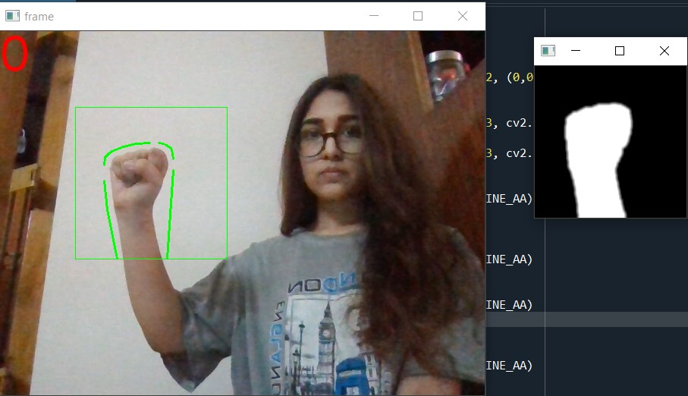
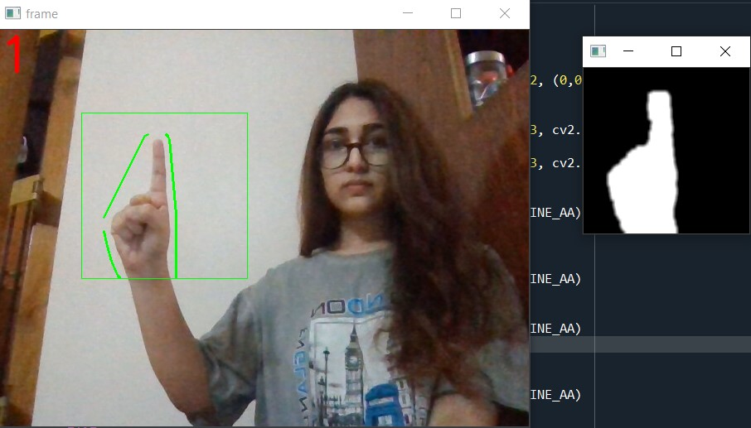
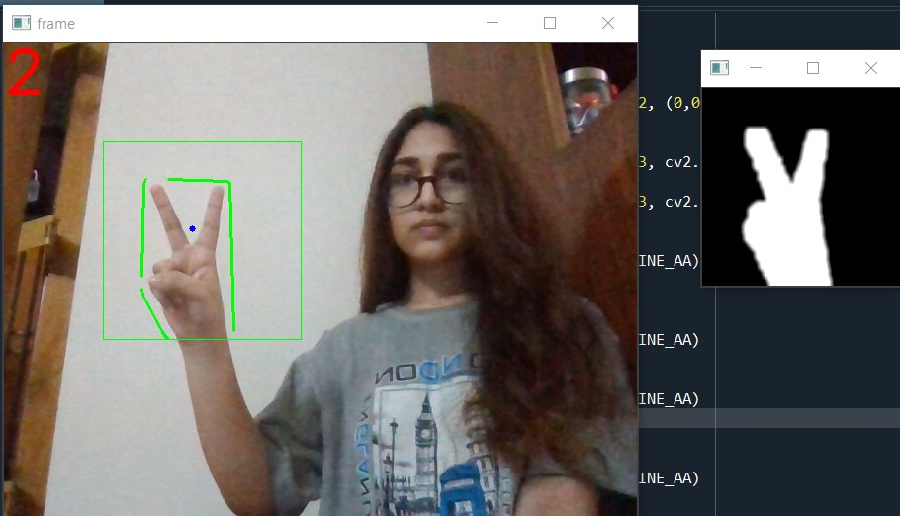
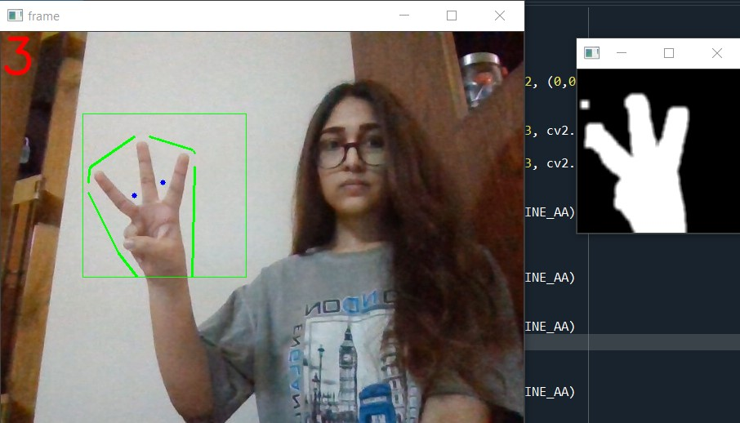
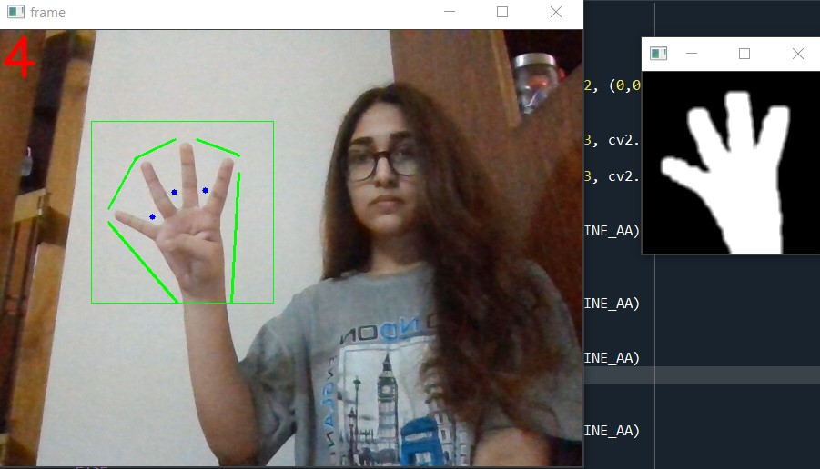
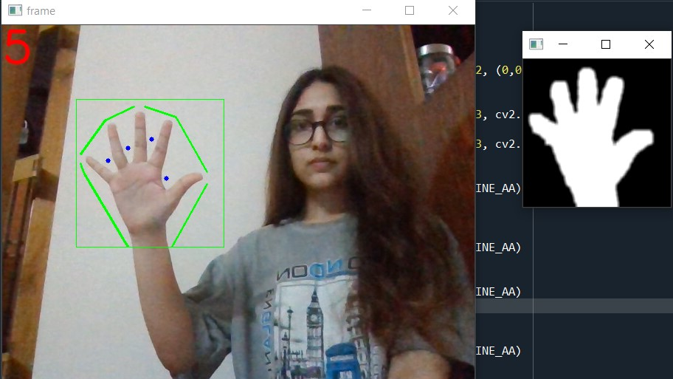
Recognition of different hand gestures using real time webcam

Slide 17
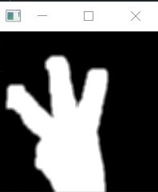
Thresholded regions of interest simultaneously displaying the hand gestures

Slide 18
Real time application: Pyauto GUI
if areacnt<2000:
cv2.putText(frame,'Put hand in the box',(0,50), font, 2, (0,0,255), 3, cv2.LINE_AA)
else:
if arearatio<12:
cv2.putText(frame,'0',(0,50), font, 2, (0,0,255), 3, cv2.LINE_AA)
else:
cv2.putText(frame,'1',(0,50), font, 2, (0,0,255), 3, cv2.LINE_AA)
elif l==1:
cv2.putText(frame,'2',(0,50), font, 2, (0,0,255), 3, cv2.LINE_AA)
pyautogui.typewrite([‘space’], 0.5)
elif l==2:
cv2.putText(frame,'3',(0,50), font, 2, (0,0,255), 3, cv2.LINE_AA)
pyautogui.hotkey(‘ctrl, ‘left’)
elif l==3:
cv2.putText(frame,'4',(0,50), font, 2, (0,0,255), 3, cv2.LINE_AA)
pyautogui.hotkey(‘ctrl, ‘right’)
elif l==4:
cv2.putText(frame,'5',(0,50), font, 2, (0,0,255), 3, cv2.LINE_AA)
#Hand gesture 2 represents play/pause button in VLC
#Hand gesture 3 represents backward/rewind button in VLC
#Hand gesture 4 represents forward button in VLC

Slide 19
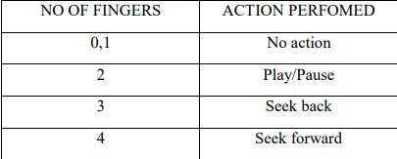
Hand gestures and their corresponding VLC media player actions

Slide 20
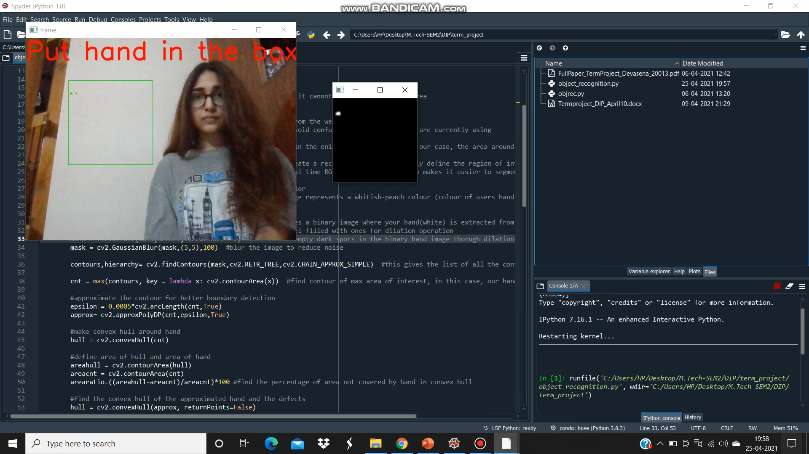
Video Demonstration of Code
Hand gesture recognition

Slide 21
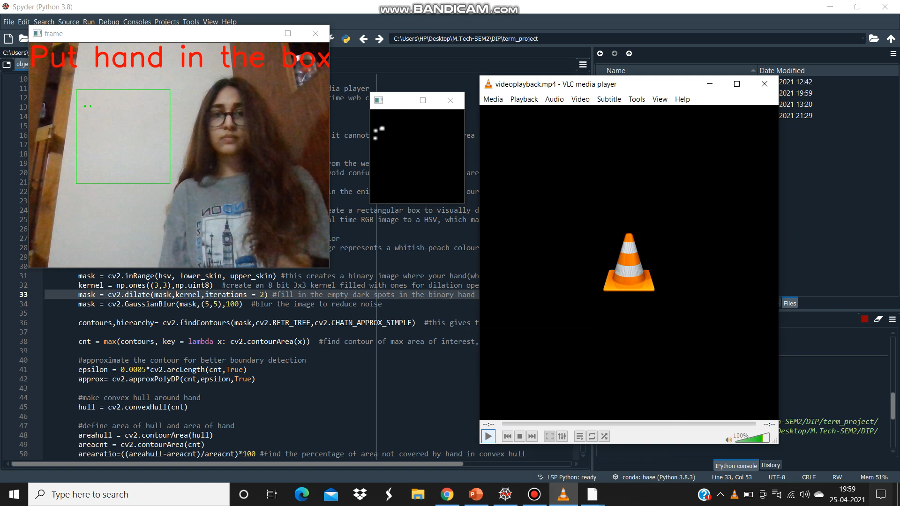
Real time application using to control VLC media player

Slide 22
Inference and Conclusion
I have found out that without performing pre-processing operations, it is difficult to get the desired results especially after thresholding. If we do not perform these operations, then the computer might not be able to correctly detect the defects and contours on the thresholded image of the hand.
I have used a mixture of dilation and gaussian blur operations to enhance my thresholded image because, initially the image had many black holes which could be filled with ones(white pixels) using dilation operation. Then I used gaussian blur to smoothen out any unwanted noises in the image. (I selected gaussian blur as it will not portray any ringing effect)
I performed two iterations for dilation operation and chose a rectangular 3x3 kernel for it, whereas I used a 5x5 kernel for implementing gaussian blur. These values were obtained after a trial and error method. If I performed more number of dilation operations, the hand became thick and unrecognizable after thresholding. Similarly using a 3x3 kernel for gaussian blur did not bring about much changes in the figure.
By converting image from RGB to HSV format, it was easier to extract the colour codes as only hue and saturation parameters are required(which can be obtained from the HSV chart) unlike all the three components in RGB format. Depending upon an individual’s skin tone, the HSV values in the code vary.

Slide 23
After directly finding out the contours and convex hull, I did not get a satisfied result, as the contour was not exactly along the boundary of my hand. That is why I performed an approximation operation on the contours so that it fits better to my hand in the image.
Sometimes due to extra noises in the background, the computer was detecting my wrist as a defect point due to which the hand gestures were not recognized correctly. Hence I added an extra parameter to determine the distance between the defect and the convex hull (d value) , which for my hand was approximately >30mm. So only if this ‘d’ value is greater than 30mm, will the computer recognize the fingers and increment the defects count.
For performing thresholding operation, I chose the HSV method instead of Otsu’s thresholding, as it gave better results, and the HSV method can be used for thresholding, easily for different skin colours.
In this code, I first implemented hand gesture recognition, after which I added the pyautogui command to control VLC media player through my gestures. What I observed was that in this way, any kind of control can be achieved if our gestures are recognized by the computer. Not only can we control just the VLC media player but can also control other video players, mouse , keyboard etc by just adding few lines of code to our initial existing code, which is easy to understand and implement.

Slide 24
Future Work
Can be more interactive by tracking real time hand movements and controlling mouse pointer on screen.
The disadvantage is always requiring a plain background : Can be overcome with the help of background Image subtraction or Machine Learning Techniques.

Slide 25

Thank You

